Slide 1
CSCI 566: Deep Learning and Its Applications
Jesse Thomason
Lecture 11: Deep Learning and The World

Slide 2
Administrivia: Paper Roleplaying Breakout 2-Pagers
These are due the day of your breakout session
Many folks have not turned these in yet, even from two weeks ago; the 5% late day penalties apply to the 2-pagers
If you signed up for a breakout session using something other than your username, we may have trouble connecting your 2-pager to your session sign up
If you have turned your 2-pager in but know you signed up for a session using a string other than your username, let us know so we can connect the two

Slide 3
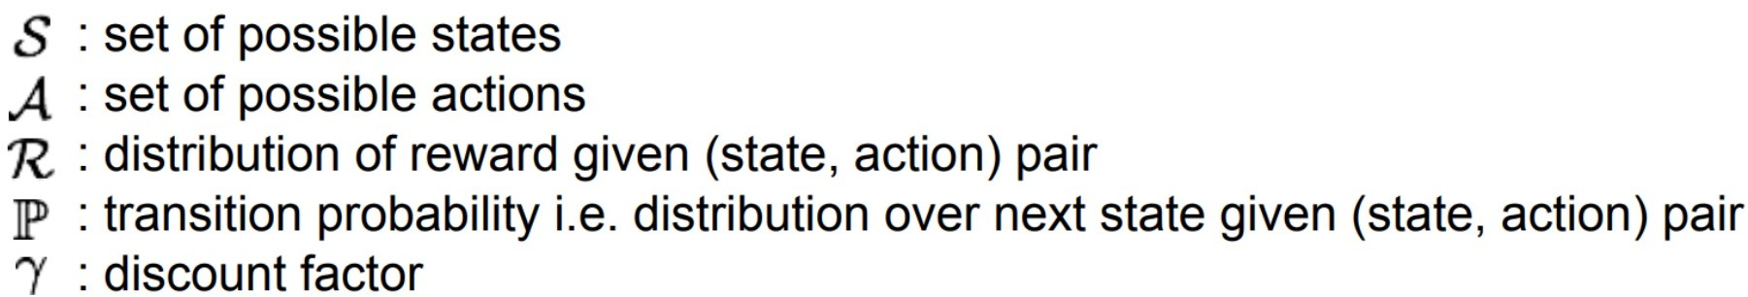
Markov Decision Process with Rewards
state
reward
World
Agent Policy
Goal: learn a policy that maximizes cumulative reward
action

Slide 4
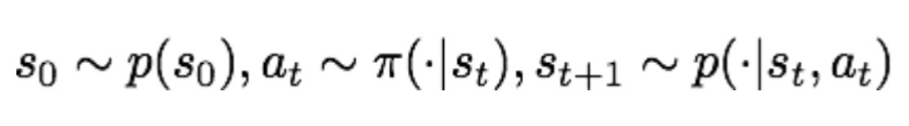
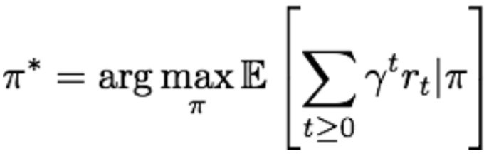
Markov Decision Process with Rewards
state
reward
World
Agent Policy
action

Slide 5
Seeking An Optimal Policy
Value Based (e.g., Deep Q-Network)
Learn Value Function
Implicit Policy
Policy Based (e.g., guided policy)
No Value Function
Directly Learn Policy
Value
Policy
Actor-Critic
Learn Value Function
Learn Policy
Actor- Critic
Value-Based
Policy-Based

Slide 6
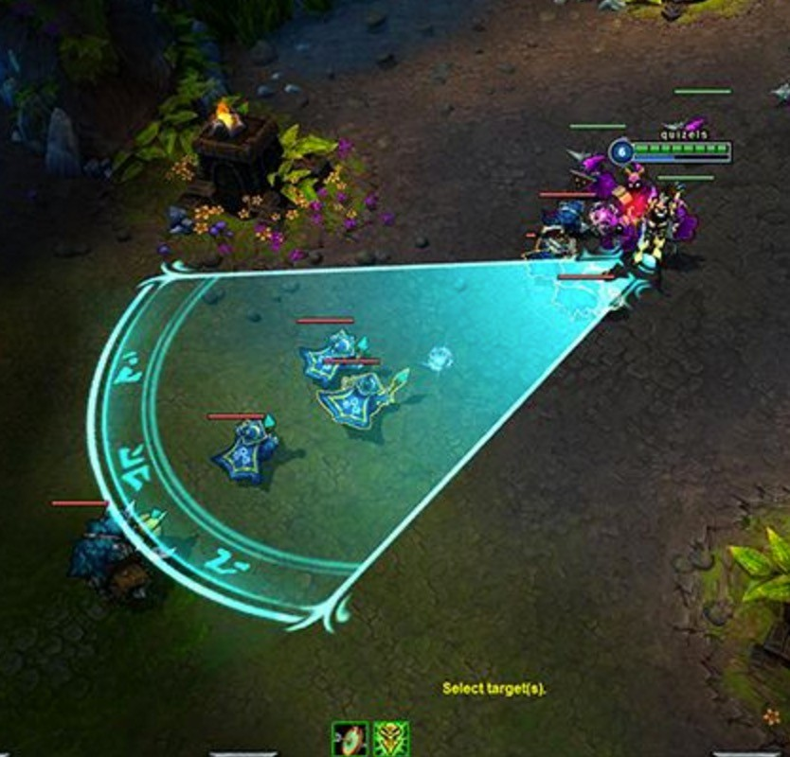
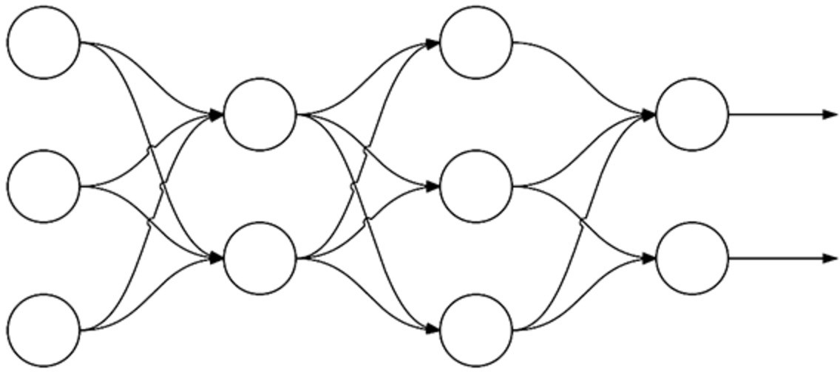
Supervised Learning versus Policy Gradient
Forward Pass
log probabilities of actions
-1.2 -0.36
Loss
Gradients 1.0 0
Ground truth
Backward Pass
Learn: 𝝿: S → A for 𝝿 parameterized by 𝝷
Deep Reinforcement Learning: Pong from Pixels

Slide 7
Supervised Learning versus Policy Gradient
Forward Pass
log probabilities of actions
-1.2 -0.36
Sampled Action
Loss
Gradients 0 -1.0
Backward Pass
Learn: 𝝿: S → A for 𝝿 parameterized by 𝝷
Eventual Reward= -1.0
Deep Reinforcement Learning: Pong from Pixels

Slide 8
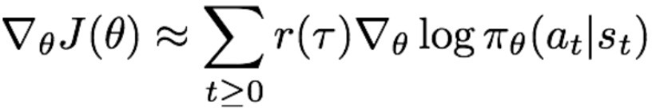
Training a Network with Policy Gradient (REINFORCE)
Forward Pass
log probabilities of actions
-1.2 -0.36
Sampled Action
Loss
Gradients 0 -1.0
Backward Pass
Learn: 𝝿: S → A for 𝝿 parameterized by 𝝷
Eventual Reward= -1.0
Deep Reinforcement Learning: Pong from Pixels

Slide 9
Seeking An Optimal Policy
Value Based (e.g., Deep Q-Network)
Learn Value Function
Implicit Policy
Policy Based (e.g., guided policy)
No Value Function
Directly Learn Policy
Value
Policy
Actor-Critic
Learn Value Function
Learn Policy
Actor- Critic
Value-Based
Policy-Based

Slide 10
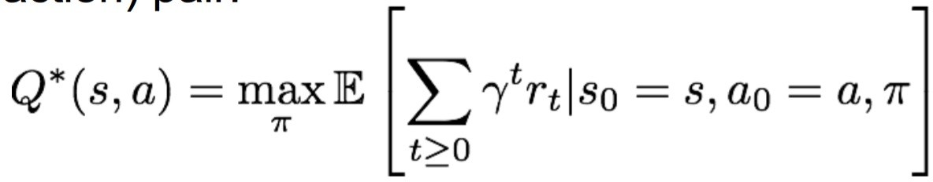
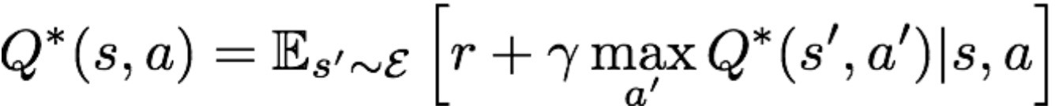
Bellman Equation
Optimal Q-value function gives maximum expected return
Such an optimal function satisfies the optimality described by the Bellman Equation:
which in a nutshell says: the highest value of a (state, action) pair is the immediate reward plus the discounted best future reward from here

Slide 11
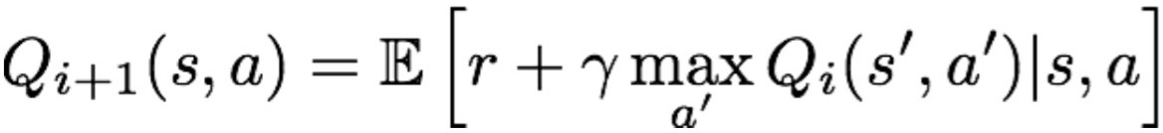
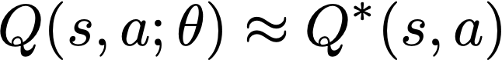
Value Iteration
Intuition: Update the Q-value function iteratively
Getting an accurate estimate Q*(s,a) for every state-action pair is intractable for continuous state/action spaces and large discrete spaces too (e.g., all possible space invaders screens)
What if we could approximate the Q function?
What’s a good way to do function approximation?

Slide 12
Training a Network with Value Iteration
Forward Pass
Action Q-value estimates
.94 .87
Backward Pass

Slide 13
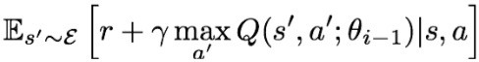
Training a Network with Value Iteration
Forward Pass
The Loss:
“Ground truth” Q*
Approximation
Estimate via value iteration intuition
Backward Pass
Update 𝜽:
Magnitude of change
Direction

Slide 14
Seeking An Optimal Policy
Value Based (e.g., Deep Q-Network)
Learn Value Function
Implicit Policy
Policy Based (e.g., guided policy)
No Value Function
Directly Learn Policy
Value
Policy
Actor-Critic
Learn Value Function
Learn Policy
Actor- Critic
Value-Based
Policy-Based

Slide 15
Seeking An Optimal Policy
Policy gradient intuition: sample trajectories with suboptimal policy, then for high reward trajectories push up action probabilities taken, for low reward trajectories push down action probabilities taken
Problem? Rewards across sometimes literally random trajectories are going to have high variance
Value iteration intuition: for every state-action pair, estimate the best future reward we could get if we chose that action from this state
Problem? Needs a lot of state-action data

Slide 16
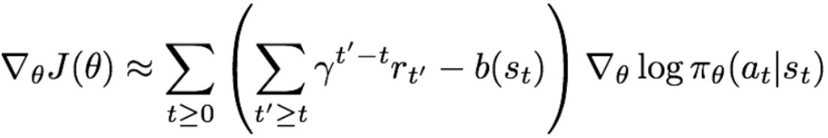
Advantage Actor-Critic Algorithm
Take advantage of the strengths of policy gradients and value iteration while removing some of their weaknesses
In particular:
Goal: Reduce variance of policy gradient updates
Method: change the parameter updates to upweight an action proportional to how much better it turned out to have been when taken versus our expectation
Discounted reward achieved from this state
Estimate of reward from this state

Slide 17
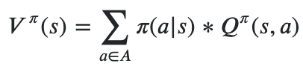
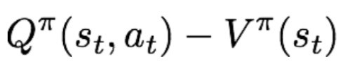
Advantage Actor-Critic Algorithm
How to estimate the reward we can achieve from a given state?
Use Q-function and value function!
Value function: integrate over quality estimates from all possible actions based on policy probability to take them
Then we call the “advantage” an action a has at state s:

Slide 18

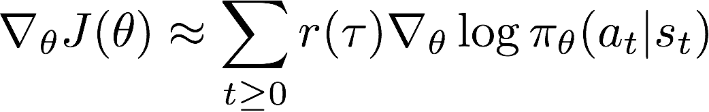






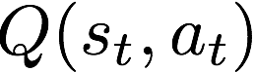
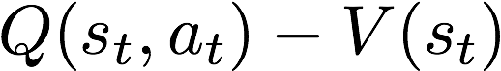
Advantage Actor-Critic Algorithm
Goal: Reduce variance of policy gradient updates
Method: change the parameter updates to upweight an action proportional to how much better it turned out to have been to take it versus our expectation

Slide 19
Advantage Actor-Critic Algorithm
Can we learn Q and Value functions?
Q-Learning + Policy Gradient methods!
Train both an Actor (policy) and a Critic (Q-function)
Actor: Which action to take?
Critic: How good the action was and how to adjust parameters?
Advantage Function:
How much better is a than expected?
Reduces the variance of policy gradient updates

Slide 20
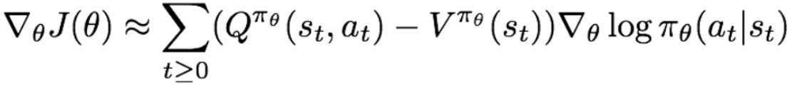
Training a Network with Advantage Actor-Critic (A2C)
Forward Pass
log probabilities of actions
-1.2 -0.36
Sampled Action
Loss
Gradients 0 -0.3
Backward Pass
Learn: 𝝿: S → A for 𝝿 parameterized by 𝝷
Advantage = -0.3
Deep Reinforcement Learning: Pong from Pixels

Slide 21
High-profile Recent Example of Deep RL?
ChatGPT!
Reinforcement Learning from Human Feedback (RLHF)
Prithviraj Ammanabrolu was doing it before it was cool
Upshot:
Remember the core function of a language model?
Autoregressive language model?
p(w_{i}|w_{i-1}w_{i-2}…w₁)
… 𝝿(a|s) for next word actions and context states
ChatGPT training uses a policy gradient fine-tuning approach

Slide 22
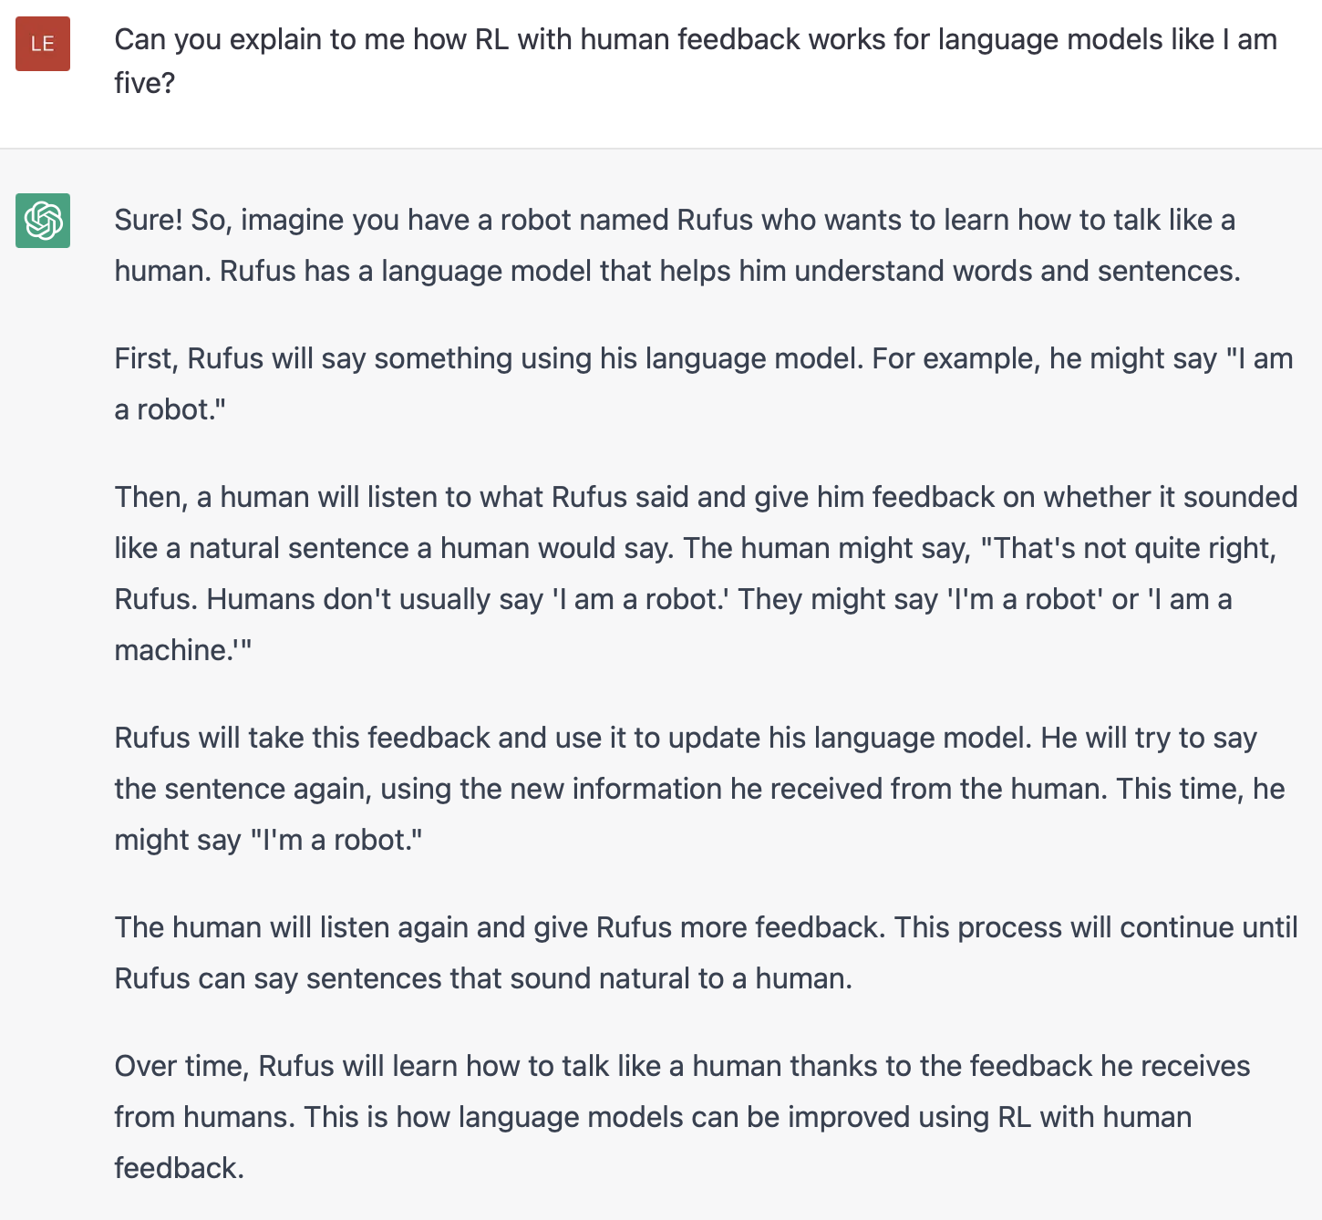
High-profile Recent Example of Deep RL
Illustrating Reinforcement Learning from Human Feedback (RLHF)

Slide 23
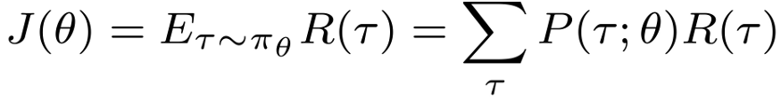
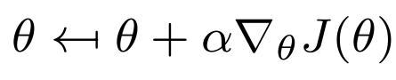
Proximal Policy Optimization (PPO)
Policy gradient:
Selecting a learning rate is a challenge; hard to pick a good learning rate given high variance in rewards
+ Policy gradient has us toss trajectories after iterations
PPO seeks to address these drawbacks.
The popular implementation right now is called “Clipped PPO”
Upshot: dynamically adjust learning updates and keep past samples around as long as they seem ‘trustworthy’ even as the policy changes so we can learn more efficiently
Proximal Policy Optimization (PPO) Explained

Slide 24
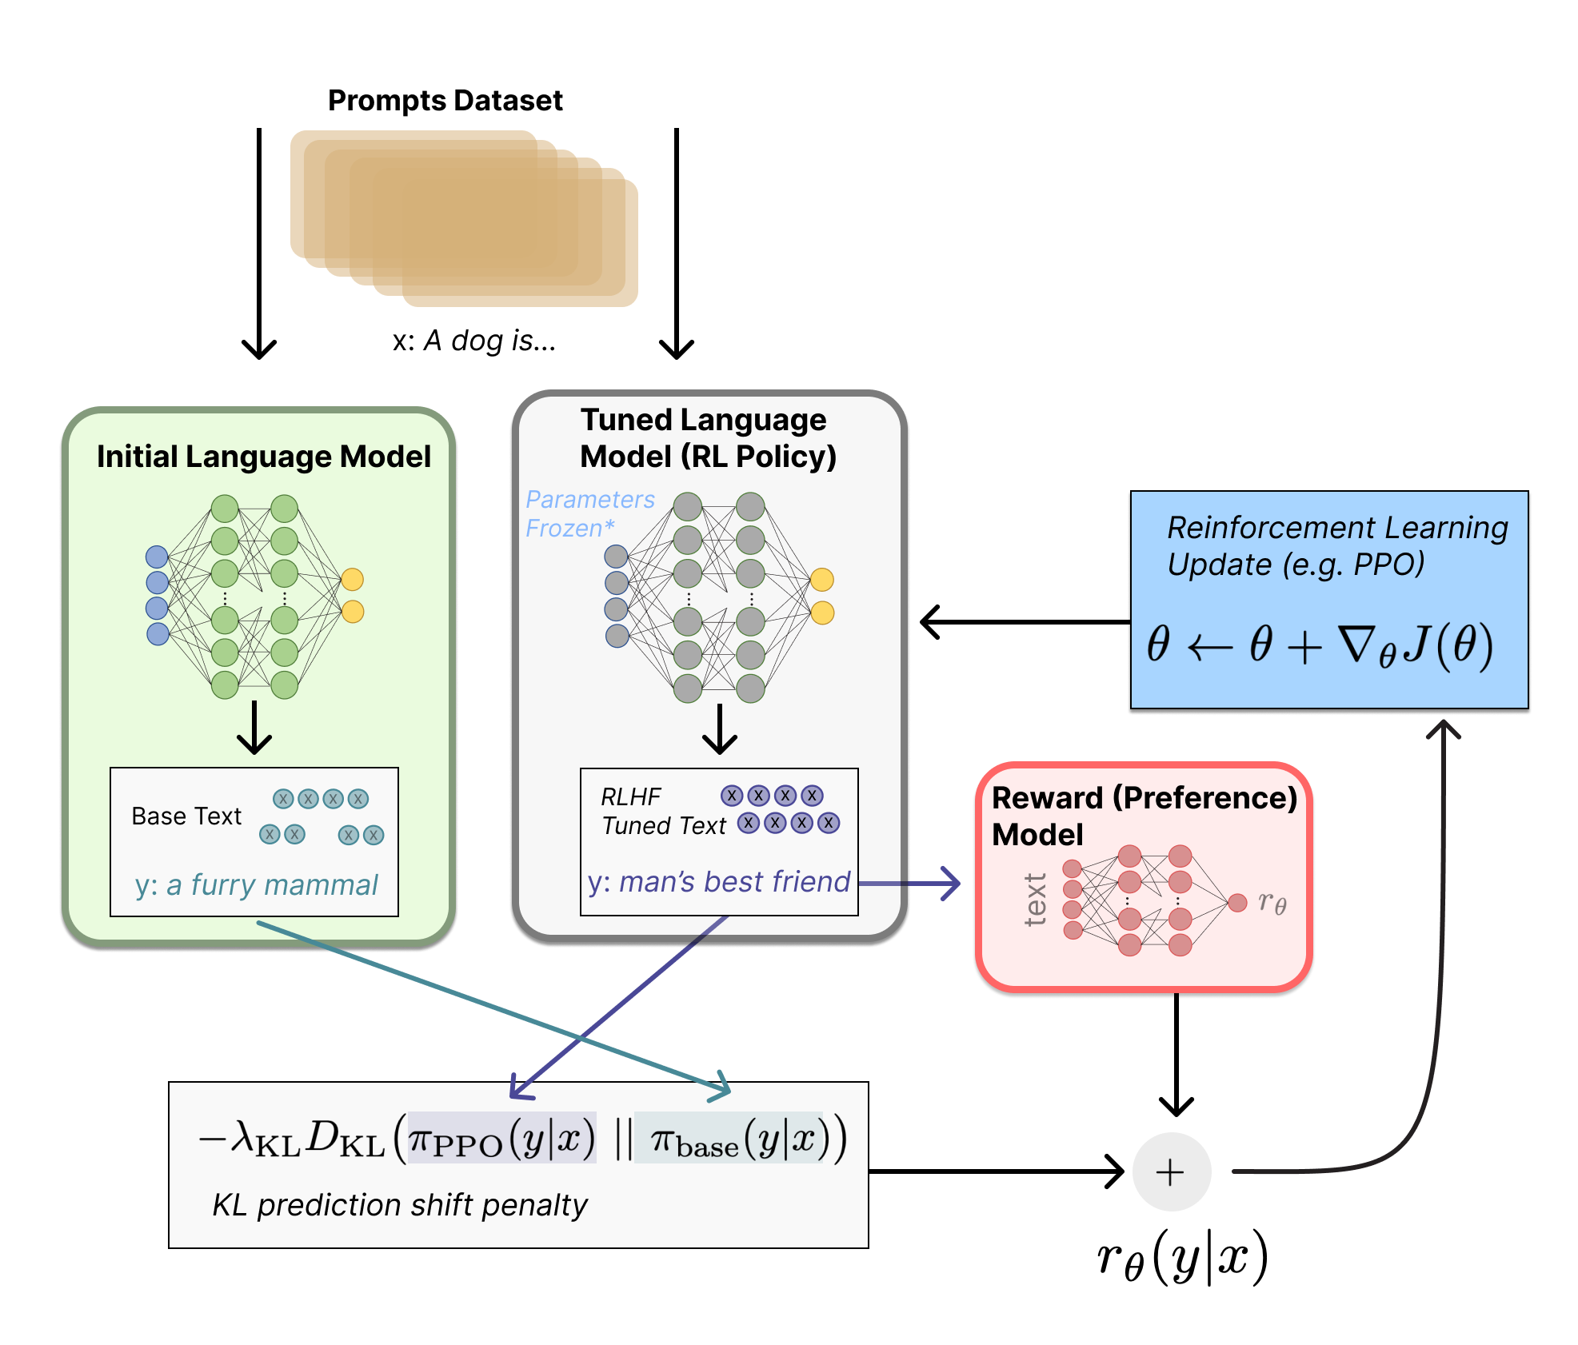
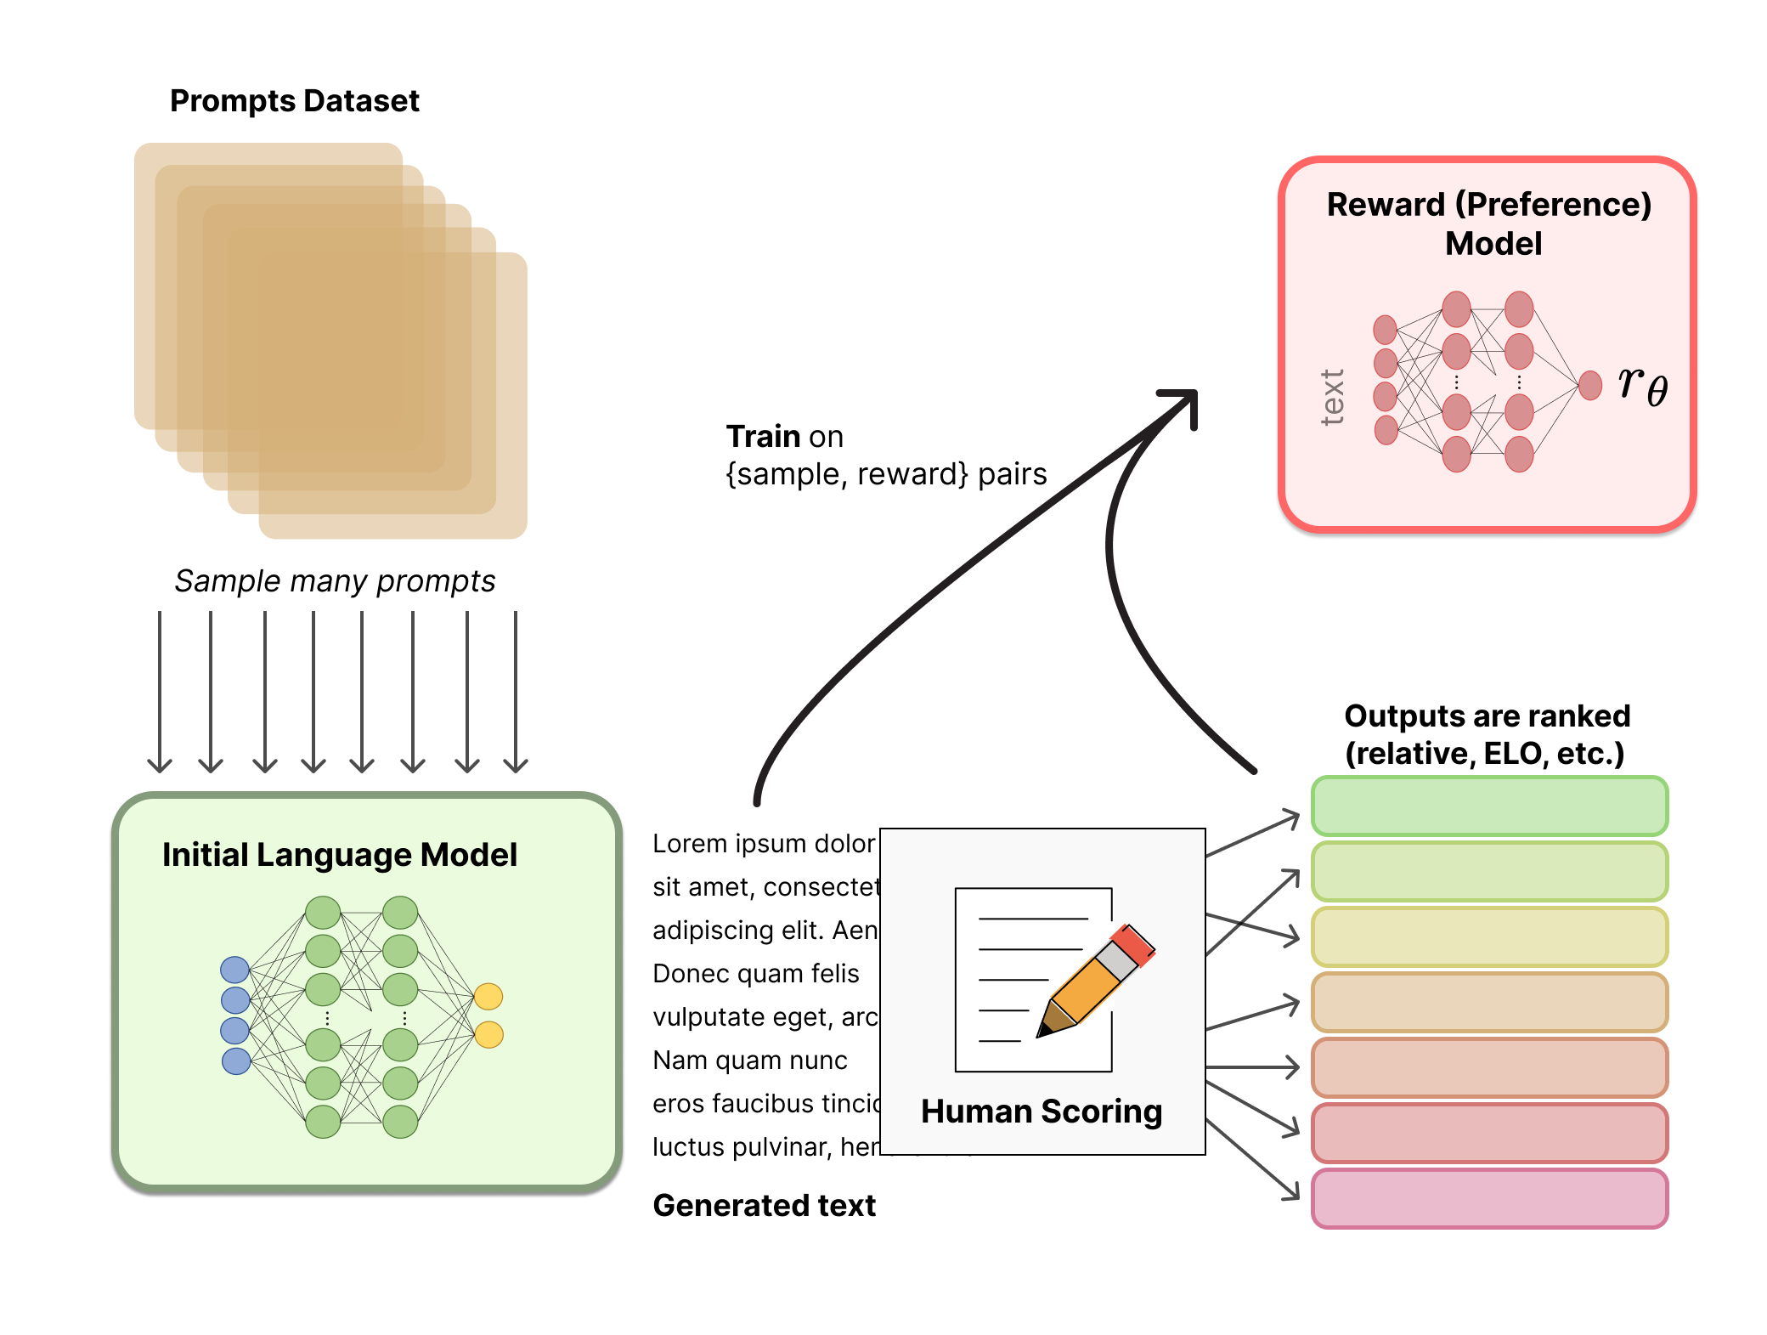
Reinforcement Learning from Human Feedback (RLHF)
Illustrating Reinforcement Learning from Human Feedback (RLHF)

Slide 25
f: X ✕ Θ → Y;
f(x;θ)=y; θ∈Θ for model M
f: X → Y;
f(x)=y
f: ɸ_{x}(X) ✕ Θ → ɸ_{y}(Y);
f(x;θ)=y
f: ɸ_{x}(X) → ɸ_{y}(Y);
f(x)=y
DL enables function approximation for f and is constrained by:
Data representation ɸ
Model architecture M
Loss function L
Optimization algorithm
Training data D
θ*=min_{θ∈Θ}(Σ_{(x,y)}L(f(x;θ), y)))
θ*=min_{θ∈Θ}(Σ_{(x,y)∈D}L(f(x;θ), y)))

Slide 26
Framing Problems for Machine Learning
If you can:
Squeeze your input and output into numerical representations (e.g., vectors)
Compose neural layers that eat something shaped like the input and spit out something shaped like the output
Define a loss function and apply an optimizer that are valid in the underlying problem and model space
Then:
Your DL model will train and loss will go down, even if you aren’t actually solving the problem you wanted to solve

Slide 27
Framing Problems for Machine Learning
What is the most general formulation of the goal of Machine Learning we can express?
Given an input x∈X, produce a desired output y∈Y, using a learned function f(x)≈y.
What’s a simple, non-degenerate learned function?
First assume we can transform input x into a vector representation, ɸ(x)=x
Then we can study a simple linear model: f(ɸ(x))=Wɸ(x)+b
Weight matrix W, bias vector b

Slide 28
f(x;θ)=𝝈(Wx+b )
ɸ_{x}(x)=x
Wx
b
Wx+b
𝝈(Wx+b)
Each output i is a weighted combination of inputs.
Each output i is the sum of Wx and bias b of len i
Each output i is exp(v) over sum of all exp(v); forms probability distribution

Slide 29
Backwards Pass
exp(W_{1,1}x₁+W_{1,2}x₂+b₁) / (exp(W_{1,1}x₁+W_{1,2}x₂+b₁)+exp(W_{2,1}x₁+W_{2,2}x₂+b₂))
x₁
W_{1,1}x₁+W_{1,2}x₂
W_{1,1}x₁+W_{1,2}x₂+b₁
exp(W_{2,1}x₁+W_{2,2}x₂+b₂) / (exp(W_{1,1}x₁+W_{1,2}x₂+b₁)+exp(W_{2,1}x₁+W_{2,2}x₂+b₂))
x₂
W_{2,1}x₁+W_{2,2}x₂
W_{2,1}x₁+W_{2,2}x₂+b₂
Loss function; high when our outputs are far from desired vector, low when they’re close to desired vector.
b₁
b₂

Slide 30
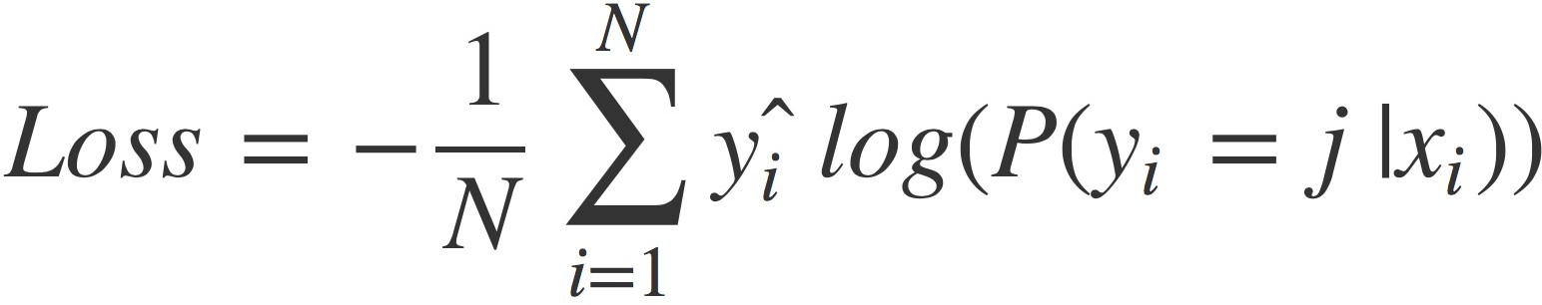
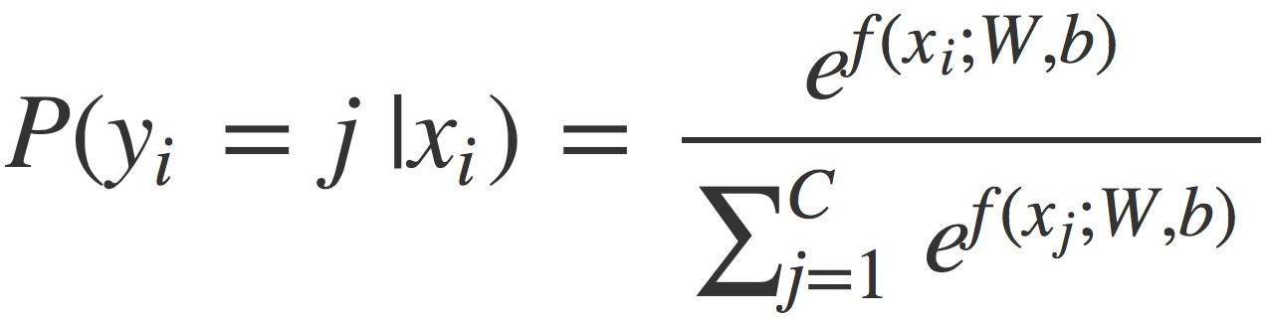
Where Does Deep Learning Come In?
Linear function: f(x,θ)=Wx+b
What loss function could we use for this n-ary classification problem?
Cross entropy
Non-linear transformation:
Our function can only capture the degree to which each dimension of the input, x_{i}, contributes to the likelihood of each class y_{j}
“... brought out the ice cold food.”
“... brought out the ice cold gazpacho.”
“... Amazing service all around. Yeah right! 🙃”

Slide 31
f(x,θ)=𝝈(W₂(𝝈(W₁x+b₁))+b₂)
W₂(𝝈(W₁x+b₁))+b₂
ɸ_{x}(x)=x
W₁x
W₁x+b₁
𝝈(W₁x+b₁)
W₂(𝝈(W₁x+b₁))
𝝈(W₂(𝝈(W₁x+b₁))+b₂)
b₁
b₂

Slide 32
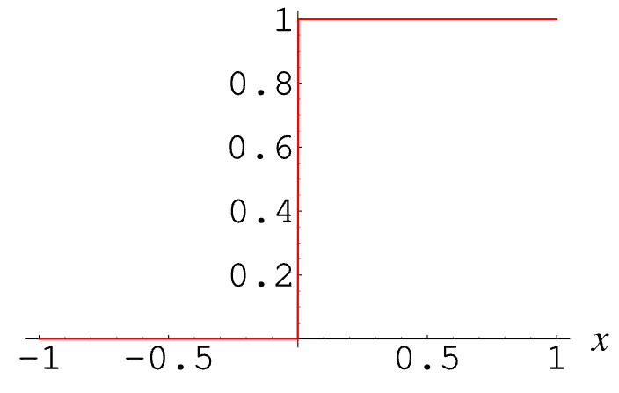
Activation Functions
ɸ_{x}(x)=x
Wx
Wx+b
a(Wx+b)
= a(W_{1,1}x₁ + W_{1,2}x₂ + W_{1,3}x₃ + W_{1,4}x₄ + W_{1,5}x₅+b₁)
If we think about a “neuron” as inspiration, the output after a should be 1 if W_{1,1}x₁ + W_{1,2}x₂ + W_{1,3}x₃ + W_{1,4}x₄ + W_{1,5}x₅+b₁ exceeds a threshold and 0 else.
What’s the “problem” with defining a this way?
b₁
e.g., a(x) = {1 if x>0 else 0}
To perform backpropagation, we need differentiable functions with non-zero gradients.

Slide 33
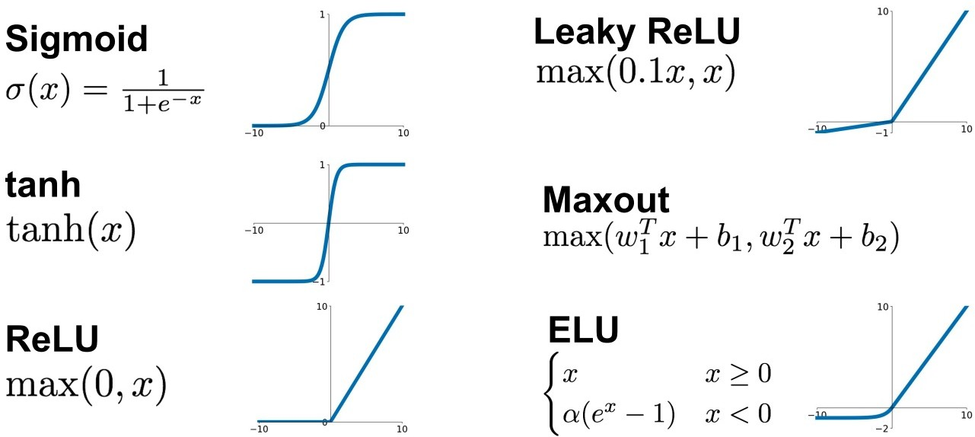
Activation Functions

Slide 34
Initialization, Normalization, Regularization
Activations are well-behaved close to zero
Weight initialization:
Gaussian; need to pick variance
Glorot / He initializations choose a variance based on activation function and number of incoming connections
Data normalization: z-scoring features to make them Gaussian
Model regularization:
Dropout for implicit ensemble learning
BatchNorm layers to address covariate shift through layers

Slide 35
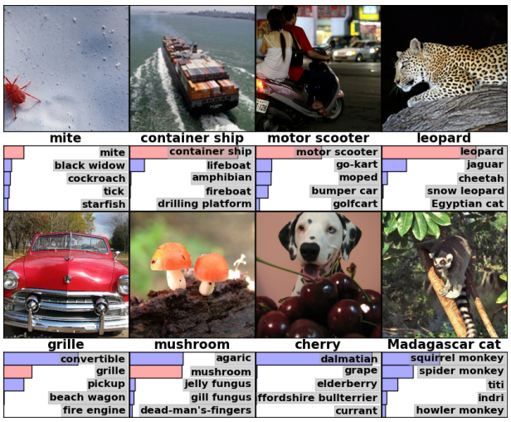
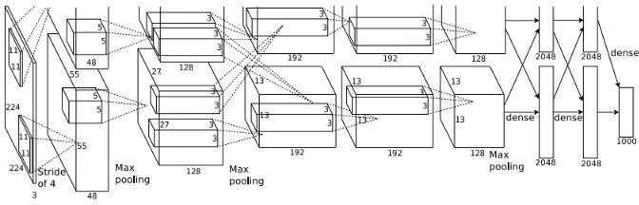
Origins of (Widespread) Deep Learning: AlexNet
A Krizhevsky, et. al. ImageNet Classification with Deep Convolutional Neural Networks. NeurIPS 2012.

Slide 36
Convolutional Layer
f_{c}(x_{A}) = Wx_{A}+b

Slide 37
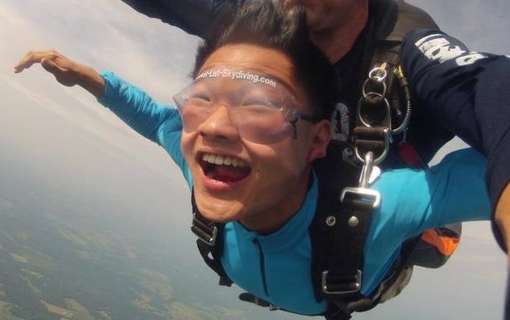
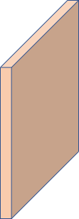




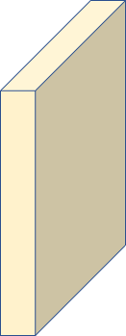

Convolutional Layer
x_{A}
28
32
28
32
ɸ_{x}( ) = [0, 1]^{(32 x 32 x 3)}
1+1+1+1=4
1
f_{c1}(x_{A}) = W₁x_{A}+b₁
3
Conv
f_{c2}(x_{A}) = W₂x_{A}+b₂

Slide 38
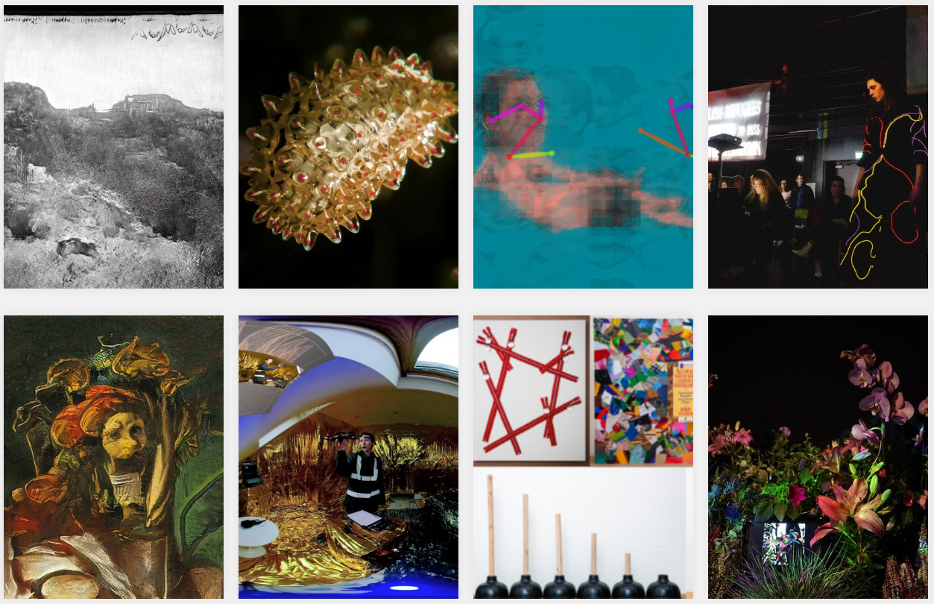
Deep Learning for Vision: Generation
AI Art Gallery. NeurIPS Workshop on Machine Learning for Creativity and Design 2020.

Slide 39
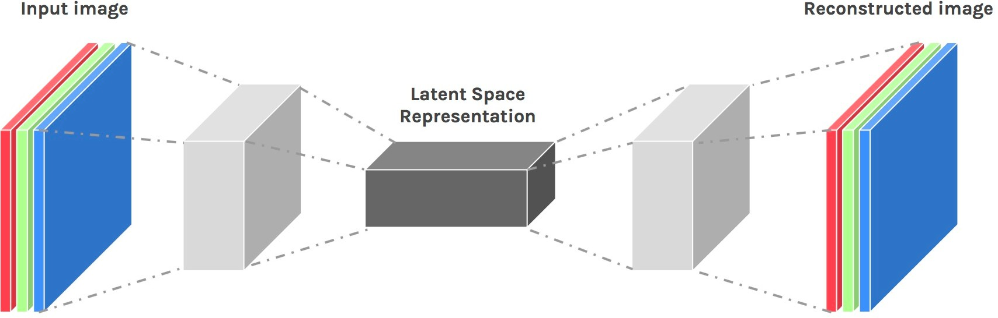

Autoencoder
The latent tensor from the encoder is a compressed representation to be decoded/decompressed.
Encoding
Decoding

Slide 40
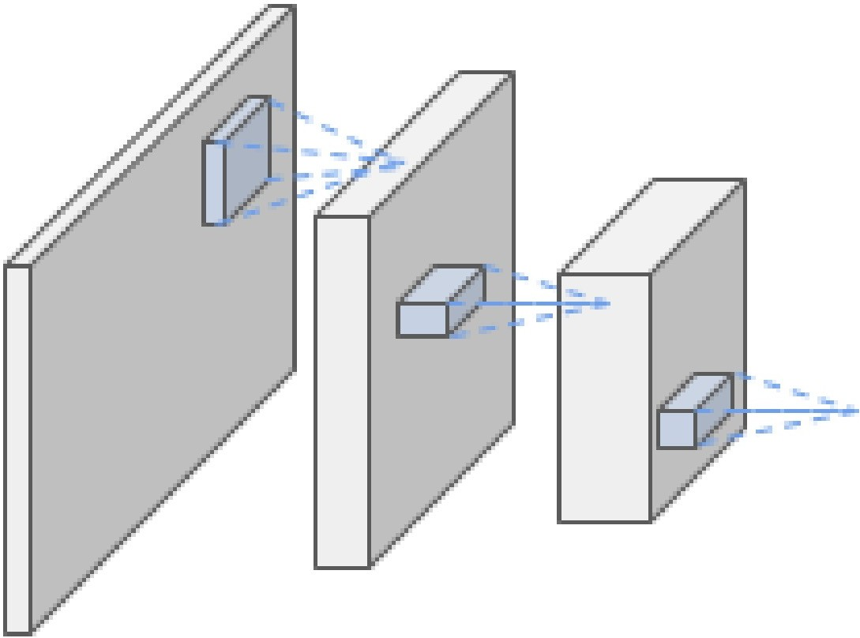
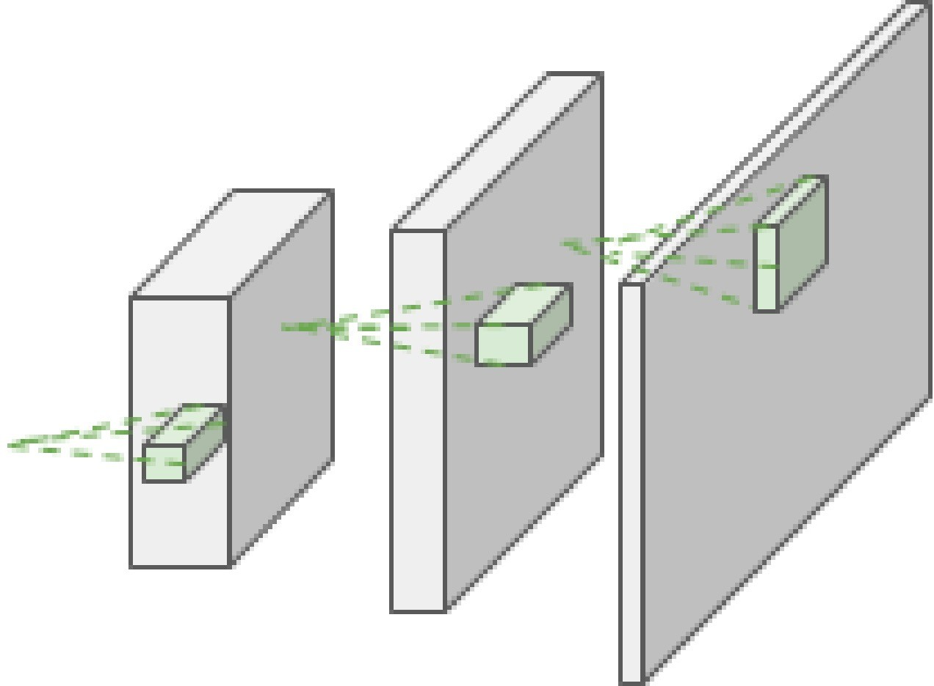
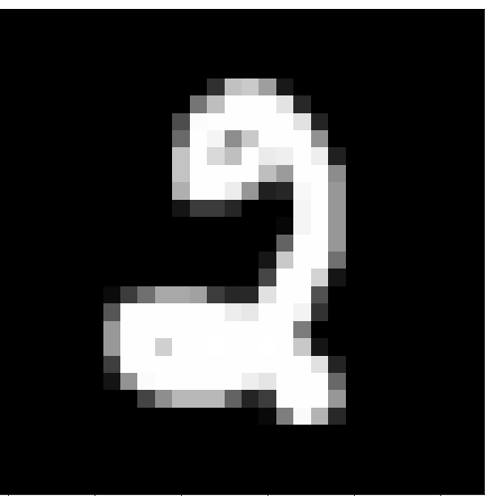
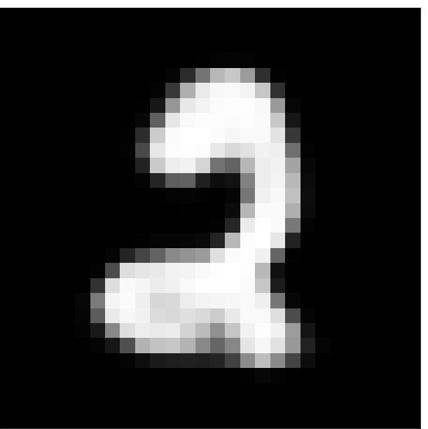

CNN Autoencoder
Reconstruction Loss L(x, x’)
Input x
Encoder
f_{e}(x;θ_{e})=z
Latent z
Decoder
f_{d}(z;θ_{d})=x’
Reconstructed input x’

Slide 41
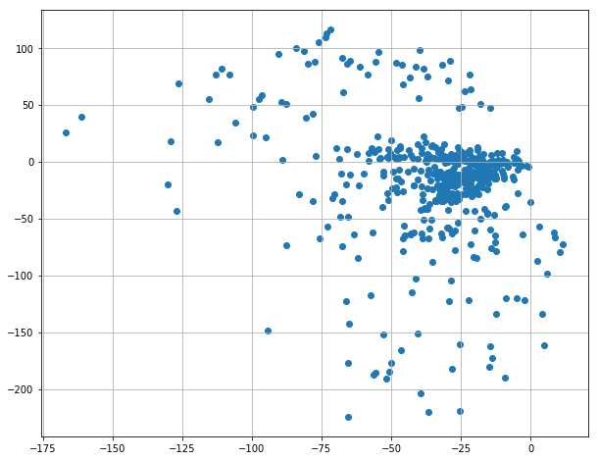

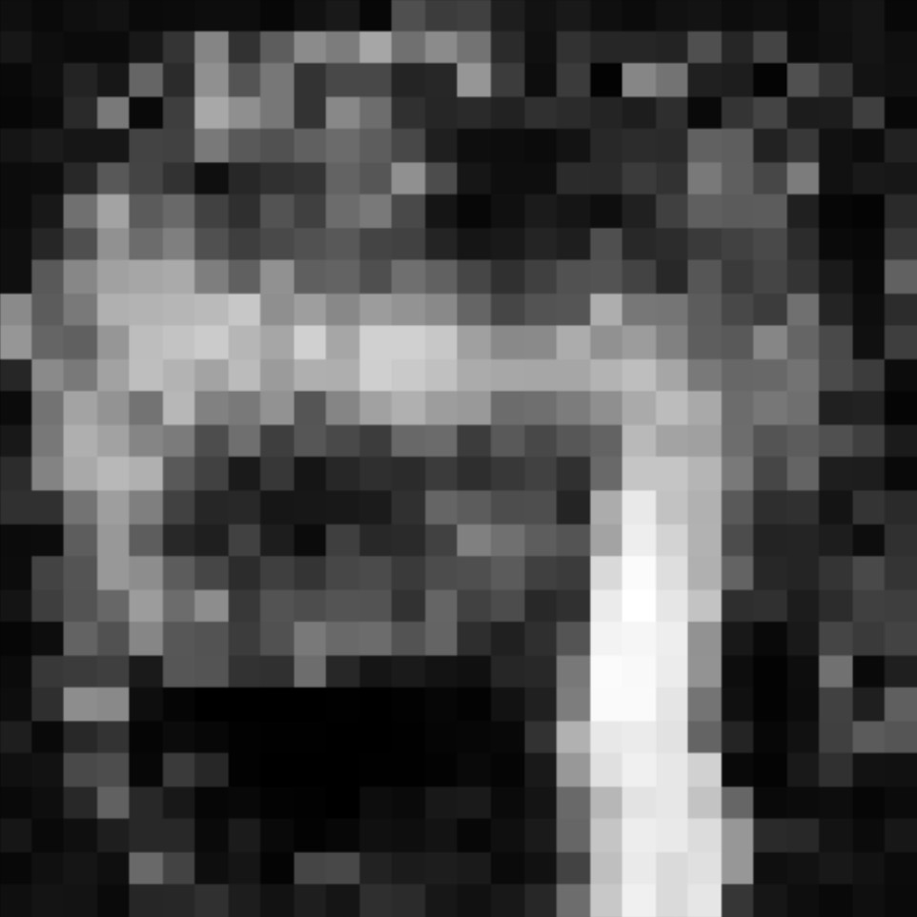
Autoencoder Decoder As Data Generator
Manifold X:
Sampled z’
Sampled z’
What if we sample vector z’ as draws from a Gaussian?
Will we achieve reconstructions that look like our input data X?
No! Our data X encodes to a particular manifold in R^{|z|}

Slide 42
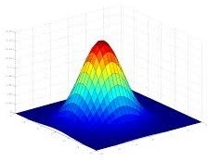
Variational Autoencoder
Latent Space Loss L_{G}(z_{μ}, z_{𝜎})
Reconstruction Loss L_{R}(x, x’)
Latent z_{μ}
Latent z_{𝜎}
Input x
Encoder
f_{e}(x;θ_{e})=(z_{μ}, z_{𝜎})
Decoder
f_{d}(z_{μ}+εz_{𝜎};θ_{d})=x’
Reconstructed input x’
We learn a mean and variance for the latent manifold for every input, then constrain those to be Gaussian

Slide 43
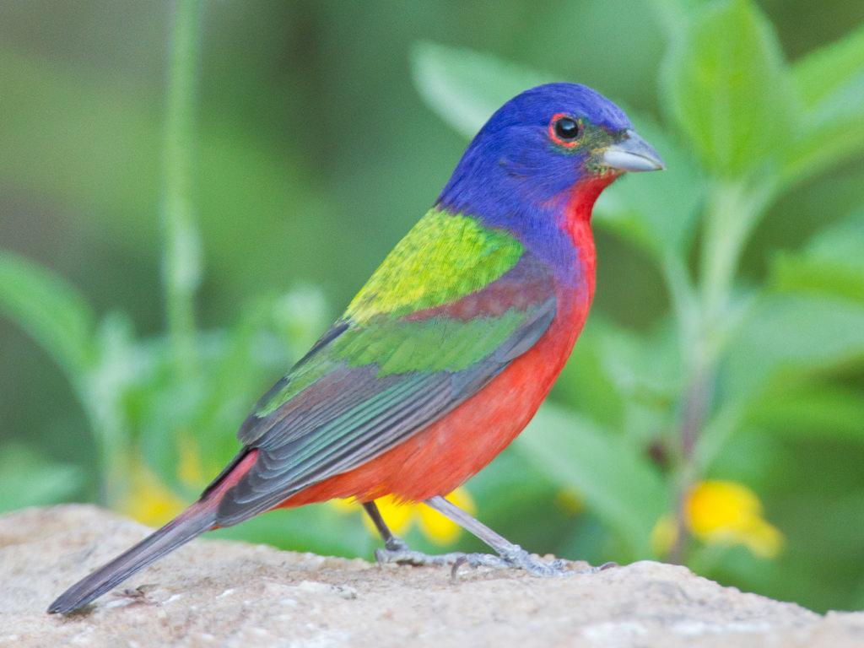
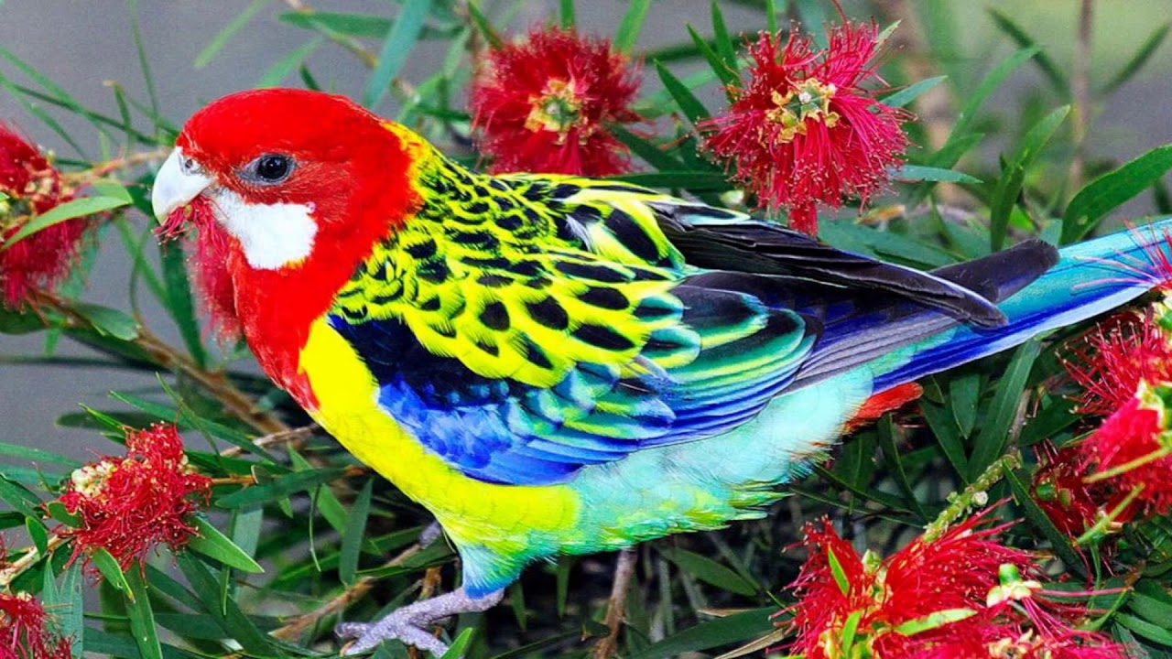
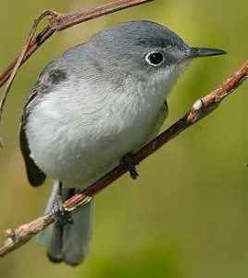
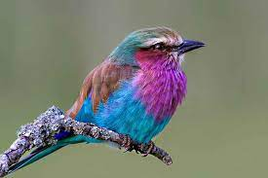
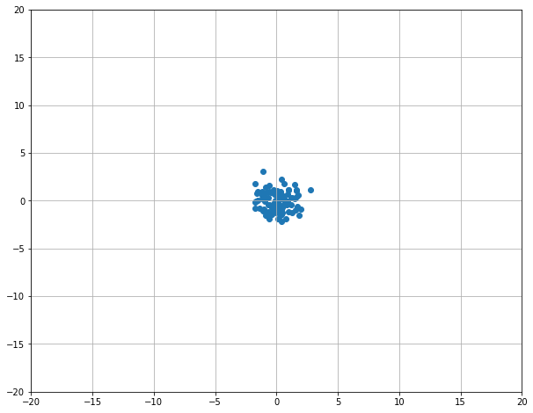
Generative Adversarial Networks
D(·)=1
D(·)=1
D(·)=0
D(·)=1
Rand N(0, 1)
Generator f(z) -> x’
Generator Network
Gen Images
Train Images
Rand z
Decoder
f_{d}(z;θ_{d})=x’
Upsampled x’
Discriminator D(x’) -> 0
Discriminator D(x) -> 1
Discriminator Network D
Discriminator Network D
Real/Fake Decision
Real/Fake Decision

Slide 44
Classes of Sequence-to-Sequence Problems
One-to-one
One input produces one output
Image classification
y
h
Person
x

Slide 45
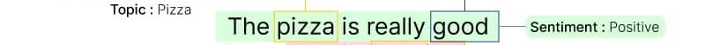
Classes of Sequence-to-Sequence Problems
Many-to-one
Sequence of inputs produces a single output
Text classification
y
h₁
h₂
h₃
h₄
h₅
…
h_{n}
x₁
x₂
x₃
x₄
x₅
x_{n}

Slide 46
n-Gram Model
An n-gram model represents the context of each word w as its co-occurrence with other words 1-, 2-, …, n-1-steps away
n-Grams are based on rigid, explicit counting, plus some smoothing to relax that rigidity
How else could we relax p(w_{i}|w_{i-1}w_{i-2}…w_{i-n+1}) ?
Previously, we kept a |V| count for each distance i-k
We could just keep a |V| count that merges distances
“Bag of Words”-based model

Slide 47
Word2Vec: Compressed Co-Occurrence Matrices
253
999
320
780
998
happy
<S>
i’m
today
<E>
Fully Connected Layer
Fully Connected Layer
Sum
Embedding V_{e}(t)
253
happy
Embedding Layer V_{e}(t)
Skip-Gram; p(w_{i-2}|w_{i})p(w_{i-1}|w_{i})p(w_{i+1}|w_{i})p(w_{i+2}|w_{i})
999
320
780
998
<S>
i’m
today
<E>
CBOW; p(w_{i}|{w_{i-2}w_{i-1}w_{i+1}w_{i+2}})

Slide 48
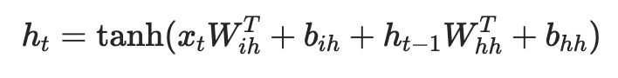
Text Classification with a Recurrent Neural Network
“Logits” for each of the |C| class labels
Fully Connected Layer F(h_{n})
RNN hidden state h
RNN
RNN
…
RNN
Embeddings E(t)
Embedding Layer E(t)
Token id t:
1
320
253
281
6
0
287
4
Word-level
served
cold
ice
cream
and
warm
pizza
.

Slide 49
Backpropagation for RNN
l₁=L(y₁, *y₁)
l₂=L(y₂, *y₂)
l₃=L(y₃, *y₃)
y₁
y₂
y₃
y₁=𝝈(W_{h→y}h₁)
y₂=𝝈(W_{h→y}h₂)
y₃=𝝈(W_{h→y}h₃)
h₀
h₁
h₂
h₃
h₁=tanh(W_{h→h}h₀+W_{x→h}x₁)
h₂=tanh(W_{h→h}h₁+W_{x→h}x₂)
h₃=tanh(W_{h→h}h₂+W_{x→h}x₃)
x₁
x₂
x₃

Slide 50
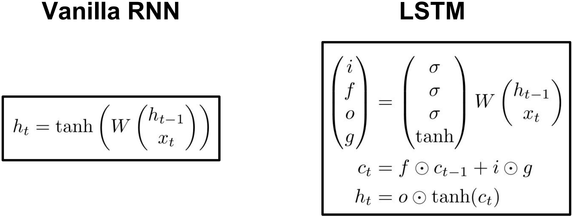
Long short-term memory
Intuition of LSTMs is to “flip” the default recurrence behavior from “squeeze out the history” to “mostly consider the history”
Hochreiter and Schmidhuber, “Long Short Term Memory”, Neural Computation 1997

Slide 51
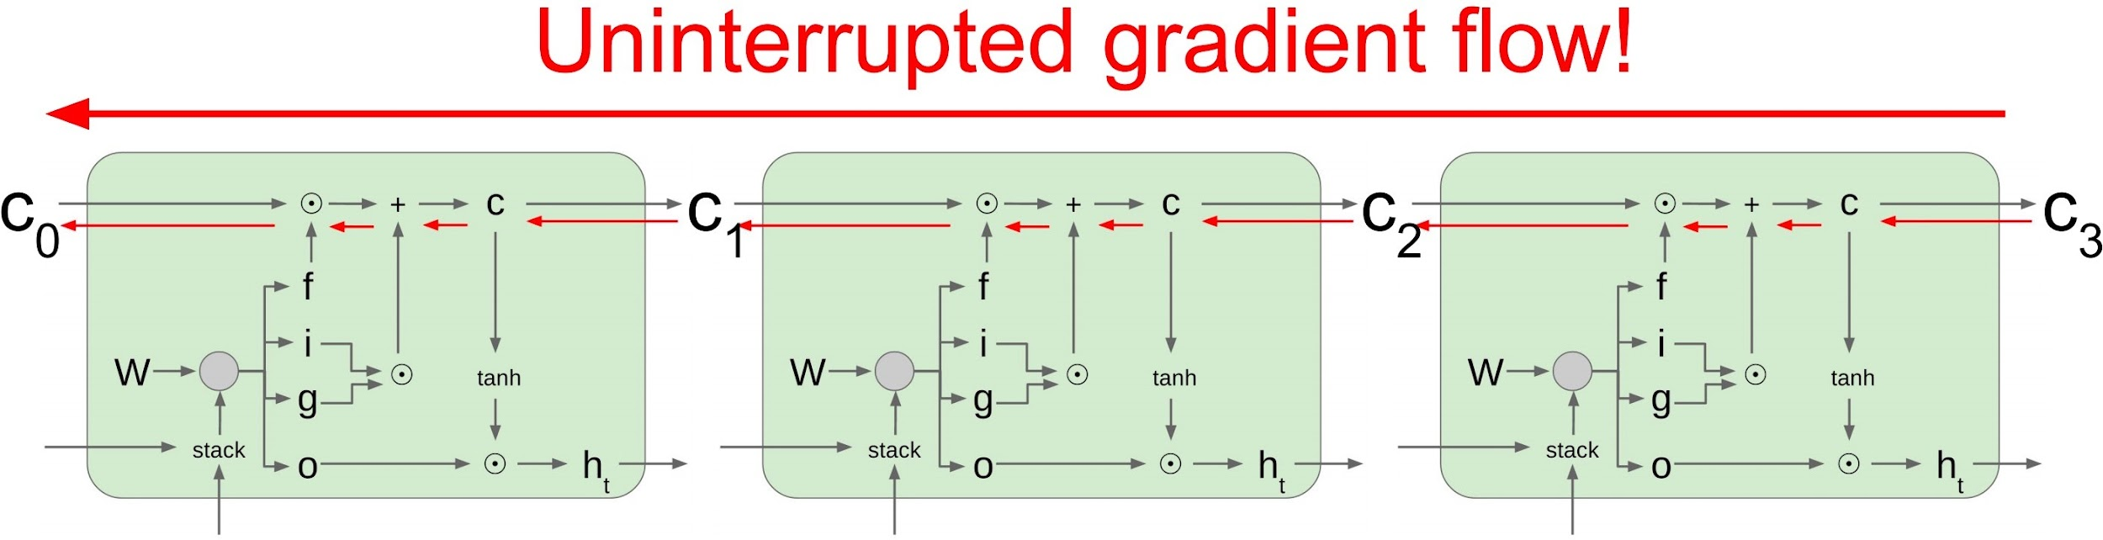
Long short-term memory

Slide 52
Classes of Sequence-to-Sequence Problems
Many-to-many variants:
Sequential one-to-one
Robot actions
Encoder-decoder
Machine Translation
y₁
y₂
y₃
y₄
y₅
y₁
y₂
Encoder Network
h₁
h₂
h₃
h₄
h₅
h₁
h₂
h₃
Decoder Network
h₄
h₅
x₁
x₂
x₃
x₄
x₅
x₁
x₂
x₃

Slide 53
Machine Translation and The Case for Contextual Info
893
شجرتان
shajaratan
s(h_{d})
Decoder D hidden state h_{d}
RNN
RNN
RNN
RNN
RNN
RNN
Embedding Layer V_{d}(t)
999
<S>
Embedding Layer V_{e}(t)
999
128
137
783
998
<S>
two
trees
sway
<E>

Slide 54
Use Attention to Rewrite RNN State Input
∈R
893
a=FC(h_{d1},h_{ei})
شجرتان
shajaratan
Σ_{i=1…L}h_{ei}exp(a(h_{d1},h_{ei}))
s(h_{d})
Init decoder D hidden state h_{d1}=h_{eN}
[Σ_{j=1…L}exp(a(h_{d1},h_{ej}))]
RNN
RNN
RNN
RNN
RNN
RNN
RNN
Embedding Layer V_{d}(t)
999
<S>
Embedding Layer V_{e}(t)
999
128
137
783
998
<S>
two
trees
sway
<E>

Slide 55


Most Recent High-Profile Deep Learning Technologies?
Stable Diffusion
ChatGPT
https://openai.com/blog/chatgpt/ ; https://huggingface.co/spaces/stabilityai/stable-diffusion

Slide 56
Transformers
Transformer T : S_{a} ⟶ S_{b} is a function from…
A set a in S_{a} to a set b in S_{b}
Simple transformer consists of a single layer encoder E and a single layer decoder D with single-headed attention

Slide 57

Transformers: Self-attention
FF
FF
FF
FF
Self Attention
Attention Is All You Need

Slide 58
Encoder-Decoder Attention
FF
FF
FF
FF
a₁
a₂
a₃
a₄
Attention(D, E, E)
Enc-Dec Attention
Attention(X_{d}, X_{d}, X_{d})
d_{1,1}
e₁
Self Attention
Attention Is All You Need

Slide 59

Bidirectional Encoder Representations from Transformers
BERT: Pre-training of Deep Bidirectional Transformers for Language Understanding

Slide 60
Masked Language Modeling Pretraining
15% of words selected for training
[MASK]
PEEL
[MASK]
PLAY
80% of those [MASK]
10% random token
10% original token
BERT: Pre-training of Deep Bidirectional Transformers for Language Understanding

Slide 61
Masked Language Modeling Pretraining
dog
cute
he
play
FC+softmax
FC+softmax
FC+softmax
FC+softmax
Transformer w Self-Attention
…
Transformer w Self-Attention
Embedding Layer [Token, Position]
[CLS]
my
dog
is
cute
[SEP]
[MASK]
PLAY
[MASK]
PEEL
he
likes
play
##ing
##le
[SEP]
BERT: Pre-training of Deep Bidirectional Transformers for Language Understanding

Slide 62

Sequence-to-Sequence Transformer
893
شجرتان
shajaratan
s(a₂)
A
Enc-Dec Attention [Attn(D, E, E)]
E
D
Self-Attention [Attn(V_{e}(T), V_{e}(T), V_{e}(T))]
Self-Attention [Attn(V_{d}(T’), V_{d}(T’), V_{d}(T’))]
Embedding Layer V_{e}(t) + P(t)
Embedding Layer V_{d}(t’) + P(t)
999
128
137
783
998
999
0
0
0
0
T
<S>
two
trees
sway
<E>
T’
<S>
∅
∅
∅
∅

Slide 63
Sequence-to-Sequence Transformer
489
تتمايلان
tatamayalan
s(a₃)
A
Enc-Dec Attention [Attn(D, E, E)]
E
D
Self-Attention [Attn(V_{e}(T), V_{e}(T), V_{e}(T))]
Self-Attention [Attn(V_{d}(T’), V_{d}(T’), V_{d}(T’))]
Embedding Layer V_{e}(t) + P(t)
Embedding Layer V_{d}(t’) + P(t)
999
128
137
783
998
999
893
0
0
0
T
<S>
two
trees
sway
<E>
T’
<S>
شجرتان
shajaratan
∅
∅
∅

Slide 64
Sequence-to-Sequence Transformer
998
<E>
s(a₄)
A
Enc-Dec Attention [Attn(D, E, E)]
E
D
Self-Attention [Attn(V_{e}(T), V_{e}(T), V_{e}(T))]
Self-Attention [Attn(V_{d}(T’), V_{d}(T’), V_{d}(T’))]
Embedding Layer V_{e}(t) + P(t)
Embedding Layer V_{d}(t’) + P(t)
999
128
137
783
998
999
893
489
0
0
T
<S>
two
trees
sway
<E>
T’
<S>
شجرتان
shajaratan
تتمايلان
tatamayalan
∅
∅

Slide 65
Sequence-to-Sequence Transformer
893
489
998
A
شجرتان
shajaratan
تتمايلان
tatamayalan
<E>
Enc-Dec Attention [Attn(D, E, E)]
E
D
Self-Attention [Attn(V_{e}(T), V_{e}(T), V_{e}(T))]
Self-Attention [Attn(V_{d}(T’), V_{d}(T’), V_{d}(T’))]
Embedding Layer V_{e}(t) + P(t)
Embedding Layer V_{d}(t’) + P(t)
999
128
137
783
998
999
893
489
0
0
T
<S>
two
trees
sway
<E>
T’
<S>
شجرتان
shajaratan
تتمايلان
tatamayalan
∅
∅

Slide 66

Deep Learning for Vision: Multi-Task Processing
MultiMAE: Multi-modal Multi-task Masked Autoencoders

Slide 67

Transformers for Vision: Patches
Learned positional embeddings! :o
An Image is Worth 16x16 Words: Transformers for Image Recognition at Scale

Slide 68

Deep Learning for Language and Vision: Captioning
Modern flashy systems don’t do image-to-text, but instead…
https://ai.googleblog.com/2014/11/a-picture-is-worth-thousand-coherent.html

Slide 69

Deep Learning for Language and Vision: Text-to-Image
https://imagen.research.google/

Slide 70


Formulating the Retrieval Problem as a Linear Model
a
bird
2
hand
0
in
1
men
1
on
0
rabbit
0
the
1
Weight of (blue, “a”)
0
Weight of (white, “bird”)

Slide 71





“A rabbit sits in the palm of a hand.”
“Children play soccer in a field.”
“A white fox is looking at the camera.”
“Men are talking on a basketball court.”
Image Embedder
Caption Embedder
Pull matching image/caption embeddings together.
Push distractor image/caption embeddings apart.
L
L
I
I
L
Learned Projection
Learned Projection
I
L
I

Slide 72


Contrastive Language–Image Pre-training (CLIP)
BPE Tokens into Transformer
Patch-based ViT
Maximize match
https://openai.com/blog/clip/

Slide 73

Classes of Sequence-to-Sequence Problems
Many-to-many
A sequence of inputs produces a sequence of outputs
Robot Actions
y₁
y₂
y₃
y₄
y₅
y_{n}
h₁
h₂
h₃
h₄
h₅
…
h_{n}
x₁
x₂
x₃
x₄
x₅
x_{n}

Slide 74

Deep Learning for Language and Robots: Pick-and-Place
https://cliport.github.io/

Slide 75
Some Things We Did Not Cover
Graph neural networks (GNNs)
Learn node embeddings over which we run operations like graph convolutions
Luckily you can basically imagine this because you know the intuitions for embeddings (compression) and taking advantage of locality information (e.g., CNN layer)
Fast fine-tuning and continual learning: Adapter networks, memory relation networks, in-context learning
Diffusion models and the wider space of unsupervised learning based on noising objectives (e.g., masking/cloze objectives)

Slide 76



Graph Neural Networks
https://alphafold.ebi.ac.uk/

Slide 77

Graph Neural Networks
Knowledge Graph

Slide 78

Deep Learning and The World
https://www.theverge.com/2022/3/17/22983197/ai-new-possible-chemical-weapons-generative-models-vx

Slide 79





Deep Learning and The World
https://openai.com/blog/chatgpt/ ; https://huggingface.co/spaces/stabilityai/stable-diffusion

Slide 80




Deep Learning and The World
Evaluating Gender Bias in Machine Translation (2019)

Slide 81




Deep Learning and The World
https://www.vice.com/en/article/wxdawn/the-ai-that-draws-what-you-type-is-very-racist-shocking-no-one

Slide 82


Deep Learning and The World
These examples hurt people, financially and socially, but it can get considerably worse.
In what context might such commands arise from people who don’t know a single thing about machine learned biases?
https://www.dailynews.com/2022/11/08/lapd-could-soon-add-boston-dynamics-300k-robot-dog-to-its-arsenal/

Slide 83
A (Short) History of AI
…
1990—2012: Statistical approaches + subfield expertise; hand-engineered feature extraction
Resurgence of probability, focus on uncertainty
General increase in technical depth
Agents and learning systems… “AI Spring”?
2012—2019: Excitement: representation learning
Big data, big compute, neural networks
Some re-unification of subfields
AI used in many industries
2019—...: Overhype and reckless deployment
Massive compute; uncurated, Internet-scraped data at incredible scale
Black-box models behind API paywalls; closed source development
“Move fast and hurt people” philosophy seen across AI-enabled areas

Slide 84


Overhype
2019—...: Overhype and reckless deployment
What’s a concrete indicator of overhype?
Tech Layoffs Are Happening Faster Than at Any Time During the Pandemic

Slide 85
Deep Learning and Its Applications
When I took my first computer science class in 2008, my instructor ended the course by saying:
“I have taught you enough to make you dangerous”
That attitude has been common in the tech industry for decades, and is evidenced in mottos like:
“move fast and break things” - Mark Zuckerberg
The AI toolbox is not a toy chest anymore, it’s an arsenal.
I have taught you enough to make you dangerous.
I hope I have also taught you enough to make you cautious.

Slide 86
Action Items for You
For those doing a Paper Roleplaying Breakout session today, turn in your 2-page paper role report by 11:59pm tonight through the gDrive submission form
If your final project presentation is on April 21st (one week from today), turn in your project question + multiple choice answers by tonight; your submitted question is part of your final presentation grade
Decide within your group how you want to divide the presentation; fine for one person to give, fine for all four to share, etc. Time limit will be strictly enforced

Slide 87
Acknowledgements
Thank you for your patience and aplomb; you’ve been great
We started this course with:
a green instructor (me)
half the number of seats for enrollment
half the TA support
a crappy lecture hall with loud construction outside
We end the course with final presentations from you across an exciting and versatile range of DL applications and topics
It’s possible this is the last offering of Deep Learning and Its Applications, and I’m grateful to have shared it with you

Slide 88
Paper Roleplaying Breakouts: April 14 [Schedule]
Emergence of Maps in the Memories of Blind Navigation Agents (Jesse, outside THH 201)
Learning to Explore using Active Neural SLAM (Virtual with Bingjie)
Attention Is All You Need (Virtual with Deqing)
Playing Atari with Deep Reinforcement Learning (Jesse, front of THH 201)
The Hardware Lottery (Tejas, back of THH 201)

Slide 89
CSCI 566: Deep Learning and Its Applications
Jesse Thomason
Lecture 11: Deep Learning and The World

